Slide 1
DS530 Week 3

Slide 2
Data Engineering Continued

Slide 3







Modern Data Stack
Ingestion
Data Storage
Data Source
Data
Transformation
Data Analysis

Slide 4




Benefits of the Modern Data Stack
SPEED
SCALABILITY
FLEXIBILITY
SECURITY

Slide 5
Speed
Follows the Data Analysis and Model Output
The processing of the data post transformation
Efficient pipelines to dashboards

Slide 6
Scalability
As the volume of data increases within an organization, the data architecture also grows
The data architecture should also be able to decrease if data ingestion decreases over time
Save costs
Less compute power

Slide 7
Flexibility within Ingestion
The data architecture should be able to handle both types of data:
Unstructured
Structured
The architecture must handle the different resources that the data is coming from
API Logs
File/Object Storage

Slide 8
Security
The architecture should be able to maintain regulations regarding sensitive and private data
GDPR
HIPPA

Slide 9


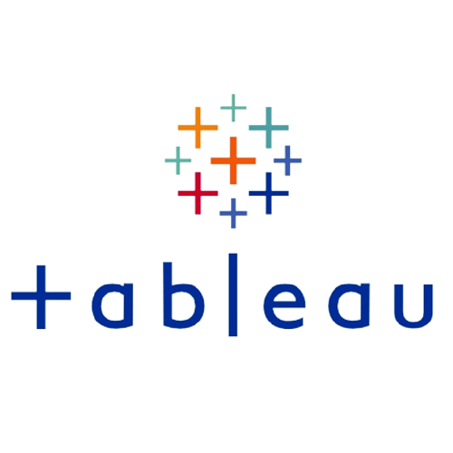





Deeper Dive into Industry Modern Data Stack
Data Modeling
EDA
Ingestion
Data Storage
Data Source
Data
Transformation
Data Analysis

Slide 10
Data Storage

Slide 11
Real-time vs Traditional Databases
Real Time
Traditional
Immediate Insights
Batch Scheduling for Data Pulls
Milliseconds of Latency
Set cadence throughout the day (hourly/daily)
Requires Complex Architecture
Straightforward Architecture

Slide 12
Real-Time Processing
Event Time Processing
Based on when they occur
Windowing
Splitting the stream into batches for calculation over a time
Exactly-Once Processing
One time processing to ensure no duplicates occur during the upload
Apache Fink:
https://nightlies.apache.org/flink/flink-docs-release-1.18/docs/learn-flink/overview/

Slide 13
Real-time Database - Components
Event Driven Architecture
Allowing the system to act on new data through calls from the source
In Memory Storage
Data is stored in the RAM instead of the disk
Indexing
Data structures that optimize querying/searching actions
Partitioning and Sharding
Distributing data through multiple nodes for a more time effect query response
Columnar Storage
Allowing for more efficient querying of specific columns

Slide 14
Data Warehouse

Slide 15
Data Warehouse
Coined by Bill Irmon in the 1970s
“Subject-oriented, integrated, time-variant, and nonvolatile collection of data”
Purpose is to centralize data from multiple sources
Be able to transform the data from multiple sources for a coherent analysis

Slide 16
Data Warehouse – On Premise
Early implementations of a data warehouse was on premise
Run on computer servers within the datacenter
Very costly
Hardware
Human resources
Hard to maintain
Complex architecture
Not scalable

Slide 17
Data Warehouse – On Cloud
Rise of Big Data through the ecommerce boom pushed on premise Data Warehouses to cloud based environments
Flexible
Scalable
Cost Effective

Slide 18

Data Warehouse – On the Cloud

Slide 19
Data Warehouse – Google BigQuery
Benefits
Serverless architecture – can use SQL queries for analysis
DuetAI embedded in BigQuery to provide coding experience
Built in machine learning
Geospatial Analysis
Security for collaboration
Data Clean Rooms
Monitor the flow of all data
https://cloud.google.com/bigquery?_gl=1*12gt07g*_up*MQ..&gclid=CjwKCAiA_OetBhAtEiwAPTeQZzKNjldNOlL0T96FuQSl0RYpvTKzODWjPTiOg-b6yxJN5F14u0_rIxoCa84QAvD_BwE&gclsrc=aw.ds#cloud-data-warehouse-to-power-your-data-driven-innovation

Slide 20
Data Warehouse – Amazon Redshift
Benefits
Best price performance with scalability
Use of no code/low code zero ETL approach for ingestion and analytics
Can run SQL queries, power dashboards/visualizations with real time analytics
Secure Data Collaboration
https://aws.amazon.com/redshift/

Slide 21
Data Warehouse - Snowflake
Benefits
Serverless architecture – can use SQL queries for analysis
Built in machine learning
Geospatial Analysis
Security for collaboration
Data Clean Rooms
Monitor the flow of all data
https://www.snowflake.com/en/data-cloud/workloads/data-warehouse/

Slide 22
Data Warehousing Strategy
Not all legacy data has to be migrated to the Data Warehouse
Use of Cloud Based Data Warehouse?
Is this a critical piece for the migration
Will legacy systems be shut off?

Slide 23
Data Warehouse – Data Gravity & Governance
Data Gravity
The event where the volume of the data increases exponentially
Very Costly to maintain mass volume that increases
Vendor Lock In
Dependency on a single vendor provider for the warehouse
Makes it very difficult to move to a different vendor

Slide 24
Data Warehouse – Measuring Effectiveness
Data Quality
Accuracy
Completeness
Consistency
Query Performance
Response Time
Execution Plans
Complexity

Slide 25
Data Warehouse – Measuring Effectiveness
User Adoption
Engagement
Feedback
Self Service
Data Integration Efficiency
Time
Success Rate
Cost

Slide 26
Data Warehouse – Data Mart
Simple data warehouse
Focused use - Specified in a specific area of the business/organization
e.g. a data mart to share information with partners
Sales, customers.
Cost efficient

Slide 27
Data Lake

Slide 28
Data Lake
Due to Ecommerce Era, semi-structured/unstructured data has become more prevalent
Social media metadata
API Logs
Documents
A Data Warehouse could not maintain data that was defined into a structured format

Slide 29
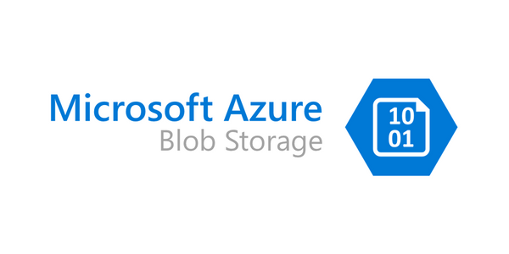

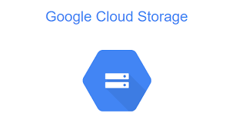
Data Lake - Organization
Hadoop Distributed File System (HDFS)
Data is stored in a hierarchical format
Similar to the File Explorer
This object storage is able to handle the high volume of unstructured data that most companies were aiming to collect
Common Tools for Data Lake:

Slide 30
Data Lake – Data Types
Data Lakes can handle all types of formats
CSV
XML
JSON
Images
Videos

Slide 31
CSV
Comma Separated Value
Most standard format
Each line represents a record
Each field is represented by a delimiter (, |)

Slide 32
Avro
Open source file format
Like CSV
Users can add a structural dictionary of the data within the file
Can support compression formats
Allowing efficient, memory saving sharing
https://avro.apache.org/docs/

Slide 33
Parquet
Open source file format
Organizes data by column
Efficient for analyzing through querying
Focus on only a subset of the columns within the database
Supports various integration processes
Most common format for enterprises
Hadoop/MapReduce/Spark
Supports Schema evolution and compression
https://parquet.apache.org/docs/file-format/

Slide 34
Data Lakes – When it Fails
Data Swamp
A disorganized lake that cannot be managed, scaled and navigate when querying
Reasons for failure
Poor Data Governance
Data Inconsistency and Silos
Lack of User Adoption

Slide 35
Data Warehouse and Data Lake Combines
Data Lakehouse
Combines the following
Lake’s storage scalability and data diversity
Warehouse’s transactional consistency and performance
https://www.databricks.com/glossary/data-warehouse

Slide 36
Data Lakehouse

Slide 37
Data Lakehouse - Components
Unified Storage
Being able to ingest from multiple data types for querying
Raw, structured, semi-structured, unstructured
Schema Enforcement
A data structure gets implemented during ingestion that ensures the data operates on a schema level when queried
Allows for high performance analysis

Slide 38
Data Lakehouse - Components
Transactional Capabilities
ACID
Atomicity
A transaction is treated as a single instance for consistency
Consistency
The transaction must meet a set rule or predefined standard to ensure mapping correctly
Isolation
Each transaction is on its own
Does not interfere with one another to ensure data integrity
Durability
After the transaction is processed, it is in a permanent state from which it has been processed within the database

Slide 39
Data Lakehouse - Components
Compute Layer
The processing and analysis stage within the lakehouse
Key part of the ML Engineering journey
From querying the data to building the model itself
Metadata Management
Provides the source information of various types of information going through
First-class citizen
Entity that supports every operation being made

Slide 40
Data Lakehouse – Transactional Data
Delta Lake
Built by Data Bricks
Fully compatible with Spark for querying data

Slide 41
Data Lakehouse – Transactional Data
Delta Sharing
A secure data sharing protocol designed by Data Bricks
Used for real time data sharing
Platform agnostic

Slide 42
Data Lakehouse – Transactional Data
Apache Iceberg
Open source table format for high volume data
Speed of the data is slow
Not tied to any particular search engine
https://iceberg.apache.org/docs/1.3.1/

Slide 43
Data Lakehouse – Transactional Data
Apache Hudi
Hadoop Upserts Deletes and Incrementals
Used for record level modification of your dataset
https://hudi.apache.org/docs/overview/

Slide 44
Data Lakehouse – Machine Learning
Once extracted, ML Engineers and Data Scientists can develop their frameworks
Python
For EDA, Cleaning, Feature Engineering, Ensemble Models
Deep Learning
Natural Language Processing for textual analysis
Generative AI
Building out the pipeline to train models like DALLE, CHATGPT, and Midjourney

